Slide 1
The Capstone Project
Battle of Neighborhood: Best Bubble Tea Location in City of Toronto

Slide 2
Mission Statement
Bubble tea has now become an increasingly popular drinks among young people. A friend of mine is looking to invest in a bubble tea store in a Toronto.
They are looking to choose a good location for their new bubble tea store.
They have provided two main guidelines for their new store:
First, a location that has higher than average monthly average apartment rent since we believe higher income population tend to have higher chance of purchasing bubble tea.
Second, we would like our store to close to at least 5 Asian restaurants. we want to place our store near Asian restaurants, since we think Asian food and bubble tea are supplement products.

Slide 3
Data Source
We would like to employ Toronto’s neighborhood information (latitude and longitude) of City of Toronto are scrapped from Wikipedia page. (https://en.wikipedia.org/wiki/List_of_postal_codes_of_Canada:_M)
Wikipedia page provides geo coordinate for each neighborhood in the city of Toronto.
Venues information are provided by Foursquare developer API. We will use venues information for each neighborhood to aggregate food/drink service provider.
Housing and rent data for each neighborhood are from 2018 October CMHC Rental Market Survey.

Slide 4
Methodology
To find the desired location to meet the requirement, we want to first employ KMeans clustering to perform clustering for all neighborhood’s in the city of Toronto. After clustering, we would like to identify the neighborhood centroid that meets requirement of higher than average housing cost.
The next step is to use information provided by four squares to identify neighborhood that meet the requirement of Asian restaurant using percentile rank.
The highest-ranking neighborhood will become the target location.

Slide 5
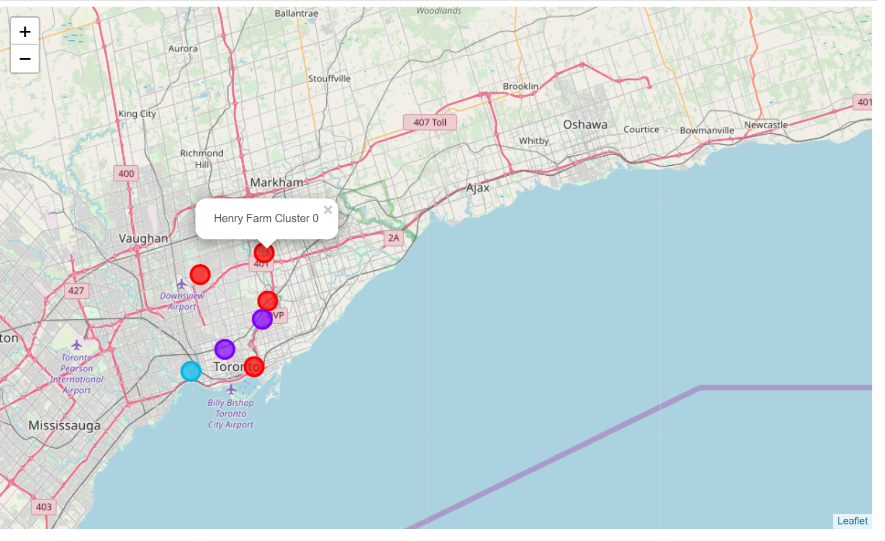
Results
The graph below shows the clustered neighborhood after filtering and selection. Three clusters are chosen to group the similar neighborhood together.

Slide 6
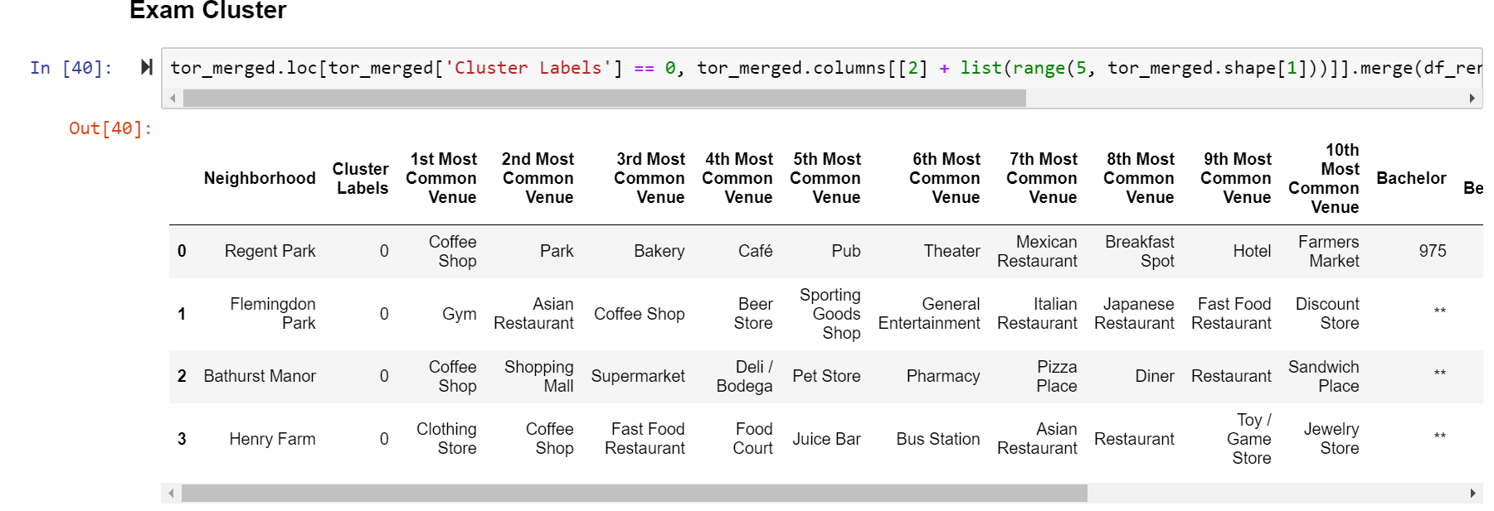
Results
Here are some details on our cluster of interest, Cluster 0:

Slide 7
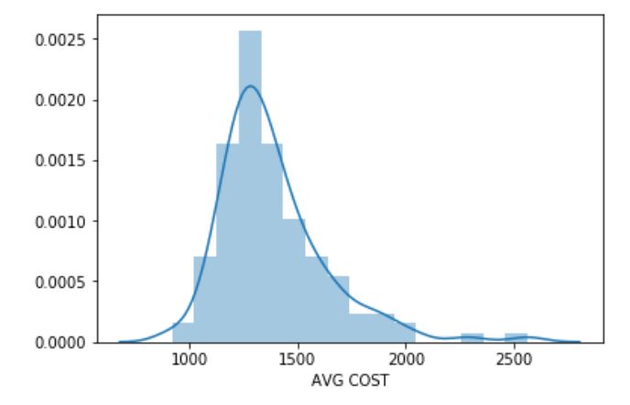
Results
The above histogram shows the distribution of average living cost for the city of Toronto by different neighborhood. The mean cost of living is CAD 1,388.

Slide 8
Conclusion
Two choice in the cluster 0 meet the requirement:
Selection1 : Regent Park with average cost of living CAD 1585
Selection2 : Henry Farm with average cost of living CAD 1634
The two selections were chosen first by K-means to group similar venues that contains a higher than average Asian restaurant. After meet the first criterion, we examined average rent in the city of Toronto by neighborhood. We filtered out selections that have lower than average cost of living. This enable us to narrow down the two finalists.
Finally since Henry Farm has more Asian restaurant than Regent Park, I suggest the ideal bubble tea location to be Henry Farm.

